Slide 1
Fake News/Rumour Detection on Social Media
Presented By :
Simarpreet Singh(40049885)
Prasanth Ambalam Jawaharlal(40042116)
Anil Heggodu Raghavendra(40042818)
Vaishnavi Venkatraj (40049798)
Vigneswar Mourouguessin (40057918)

Slide 2
WHY ?
More than half of the world's population using Social Media in their daily life.
These sites not only act as a platform for staying connected with friends but also to share information over the internet
Are all the information over the social media are credible and trustworthy ?
With the flexibility of anyone can share anything over the platform, Social Media is more prone to the spread of irrelevant and misleading information.

Slide 3
What did we do ?
Classifier:
We have designed a Binary Classifier(s) that will predict whether a given tweet is Spam or Non-Spam
DataSet:
We have chosen an High Impact Event “UK RIOT 2011”.
During the Riot lot of Fake News got spread in twitter.
Collected the Tweets over that particular period of time which is used for Training and Testing the Classifier
Implementation : ‘R’ Language

Slide 4
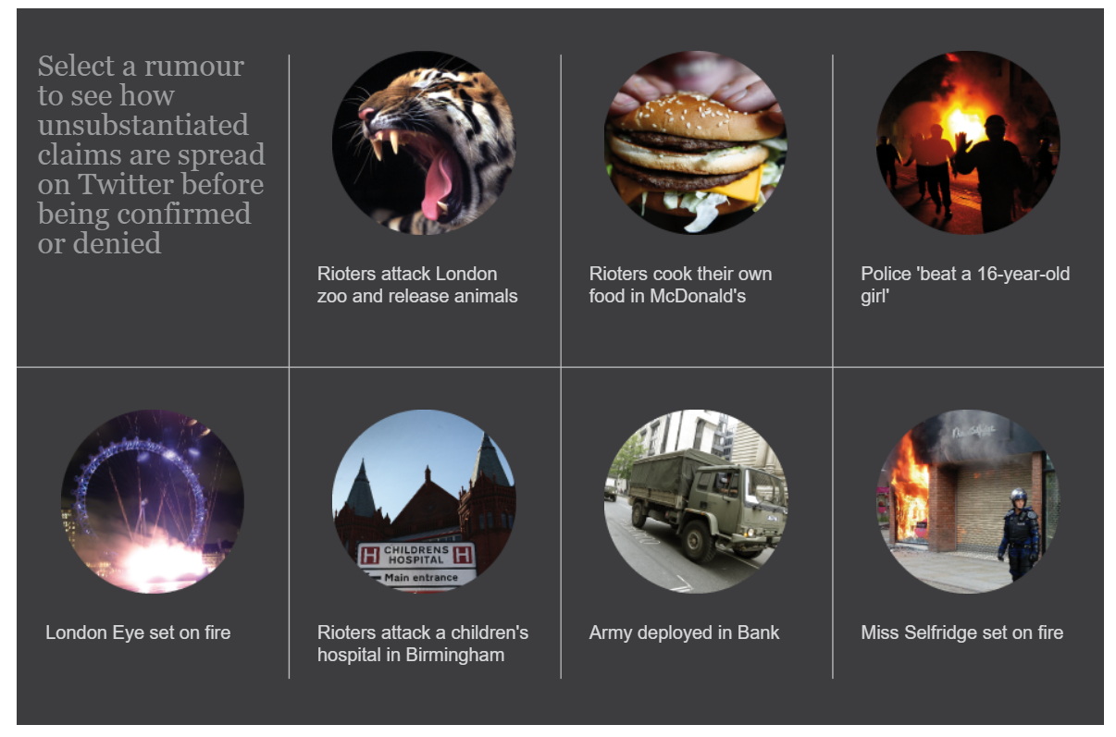
Fake News Facts - UK RIOTS 2011

Slide 5
Data Mining Steps followed..
Data Collection
Data Preprocessing
Feature Extraction /Selection
Modelling
Evaluation

Slide 6
Data Collection
Collected Raw Data from Twitter by scrapping Tweets for the event ‘UK Riots’
Raw data :
Tweet Text
Tweet Date/Time
Retweets.
Location of Tweet
User Details
No of favourites
How ?
Using the Streaming API and Trends API over a given period of time .
Will give only past 7 days of tweets
Scrape the HTML web page by scrolling infinitely to get the historical tweets

Slide 7
Extracted around 50,000 datasets as rawdata for the month of Aug 2011
The extracted raw data is filtered with the date : Aug 6 to Aug 11 2011.
The filtered raw data corresponds to 10,000 datasets.
We have splitted the 10,000 filtered datasets into two csv files :
- RawTrainingDataSet.csv
- RawTestDataSet.csv
Data preprocessing, feature selection, feature extraction and data annotations for Training and Test datasets.
The training dataset is used for modelling using SVM classifier and the model is tested for the test dataset.

Slide 8
Data Annotation :
We manually annotated the raw dataset obtained from scrapping the tweet text into two categories - Spam and non Spam.
The annotations are done based on the rumours that were spread on twitter during the UK riots
We have taken the below article from “The Guardian” as reference for annotating the tweets and categorising them as Spam or Non Spam.
If the tweet is spam, the class is assigned value -1
If the tweet is non spam, the class is assigned value 1

Slide 9
Data Preprocessing
Data Cleaning :
Cleaned Raw Data by removing missing rows from the data.
Changed the datatypes of columns as per our requirement

Slide 10
Continuation….
At the end of preprocessing, we obtain two cleaned csv files from the raw dataset:-
Training_Cleaned.csv
Test_Cleaned.csv

Slide 11
Feature Extraction/Selection
Features used corresponding to each Tweet :
1) Retweets on each Tweet.
2) Favorites.
3) Length of each Tweet.
4) Number of URL’s in each Tweet.
5) Number of Spam words in each Tweet.
6) Number of Swear Words.
7) Number of Hashtags in each Tweet.
8) Number of @ Mentioned in each Tweet.
9) Sum of all the above features except first three features.

Slide 12
Modelling
We have implemented below classifier:-
SVM
For comparing accuracy, we have used below classifiers:-
KNN
Decision tree
Naive bayes
Neural Network

Slide 13
Support Vector Machines :
SVM is the best known classification algorithm for binary classifiers.
Perform classification by finding the best possible hyperplane that differentiates the two classes very well.
We have performed SVM classification in 2D(Retweets+Favorites) and 3D(Retweets+Favorites+New_Feature) space.
Our aim was to obtain a model with minimum weight and maximum bias by developing the fit method appropriately for both 2 and 3 features set.
Predict the new dataset using the obtained model.

Slide 14
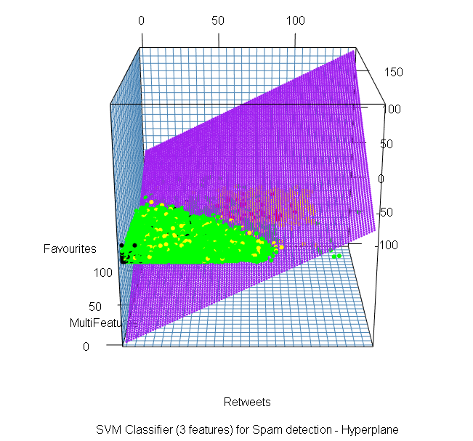
Plot for SVM
Training Data
Black (Non spam)
RED(Spam)
Test Data
Green(Non spam)
Yellow(Spam)

Slide 15
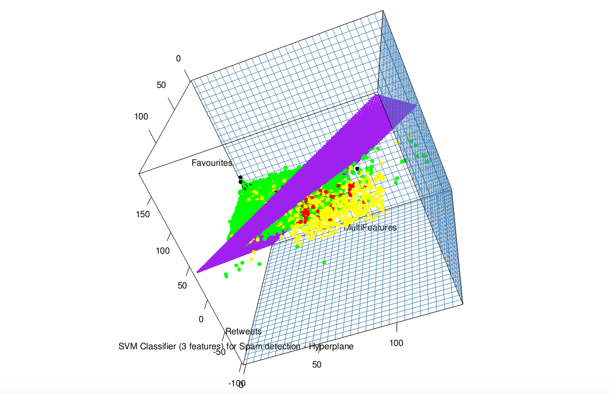
SVM (Continued ...)

Slide 16
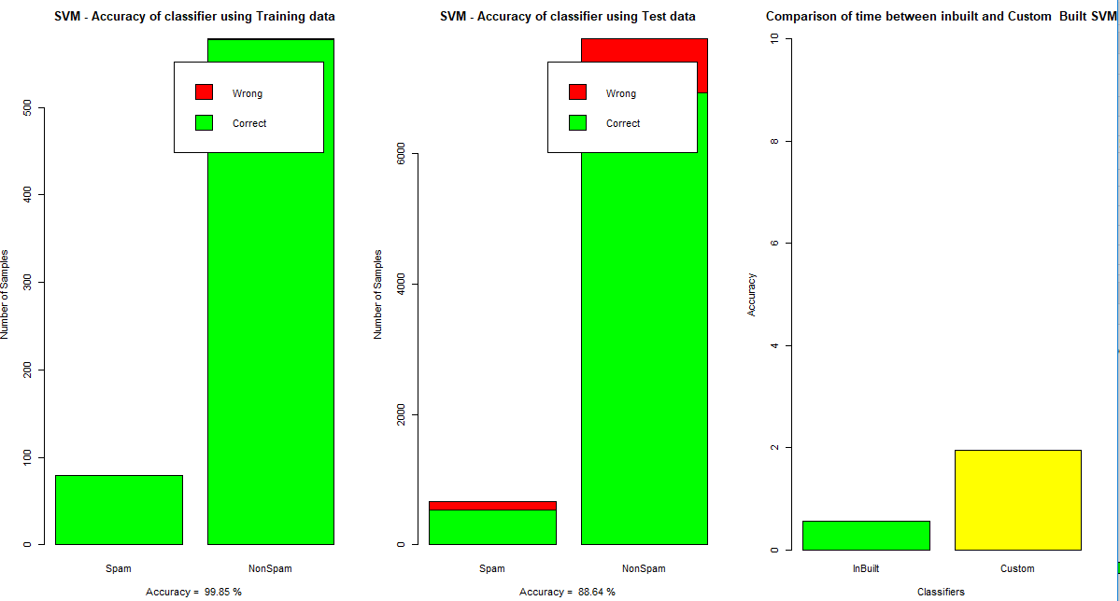
Accuracy Results & Time Execution for SVM

Slide 17
Evaluation
We are evaluating the accuracy of each of the algorithms by constructing a CONFUSION MATRIX

Slide 18
K-Nearest Neighbour
Another type of machine learning algorithm that is used for classification.
Given a value of K - the number of nearest neighbours to look for , it looks for K number of nearest points around the test point and classifies the test point in the class for which majority of K points belong to.
We have compared the accuracy of our test data for three values of K.
K=1, K=3 and K=101.
We have obtained the highest accuracy of 95.94% for K=101 .
knn.100 <- knn(train.traindataset, test.testdataset, train.def, k=101).

Slide 19
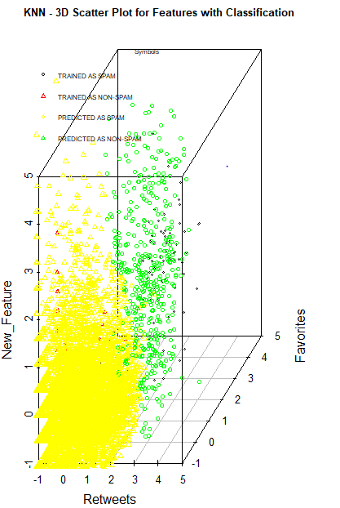
3-Dimensional Plot for KNN
Training Data
Black (Non spam)
RED(Spam)
Test Data
Green(Non spam)
Yellow(Spam)

Slide 20
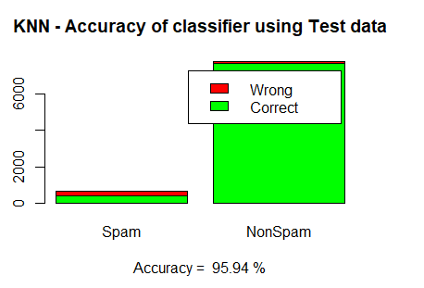
Accuracy Results for KNN

Slide 21
Decision Tree
We split the sample into two homogeneous sets (or sub-populations) based on the most significant splitter / differentiator which was Retweets in our case.
Used rPart method which models the trainingdata based on the feature with the highest gain.
mytree <- rpart(Class ~ Retweets + Favorites + New_Feature, data = traindataset, method = "class", minsplit=2, minbucket = 1,cp=-1).
Decision trees resulted in an accuracy of 80%.
Here in this case, the minimum split of the tree is 2.

Slide 22
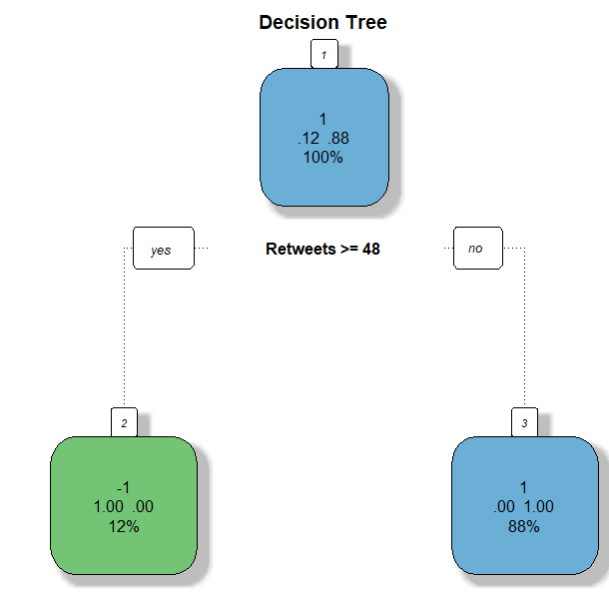
Decision Tree Model

Slide 23
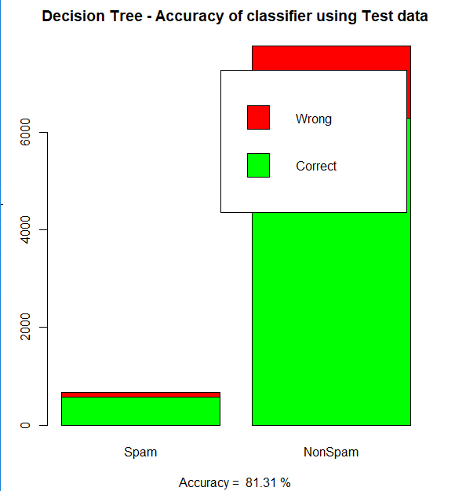
Accuracy Results for Decision tree

Slide 24
Naive Bayes
Probabilistic classifiers based on applying Bayes' theorem.
naivebayes<-naive_bayes(traindataset[,-4],as.factor(traindataset$Class),usekernel = TRUE).
Naive Bayes by default uses Gaussian univariate distribution internally, as it classifies data based on every input feature(Retweets, Favorites, New_Feature). We can change the type of distribution using density function.
Naive Bayes resulted in an accuracy of 77.49%.
Naive Bayes has been trained using the input traindataset, which inturn produces the models shown in the next slide.

Slide 25
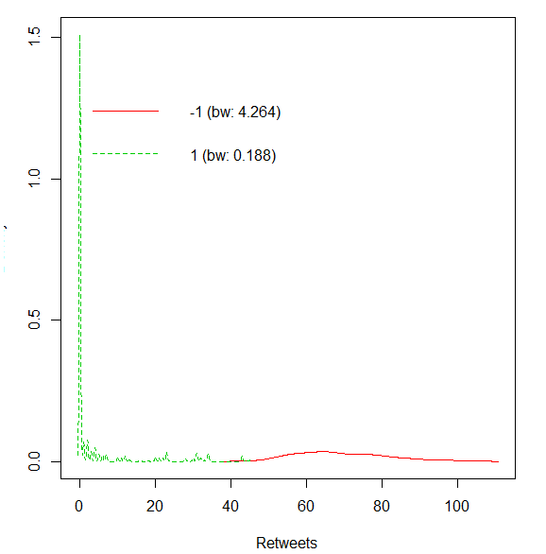
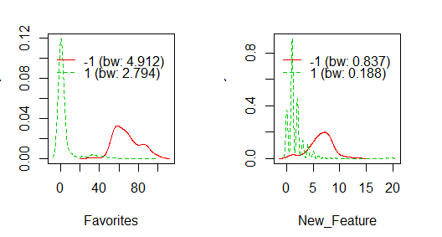
Plots for Naïve Bayes

Slide 26
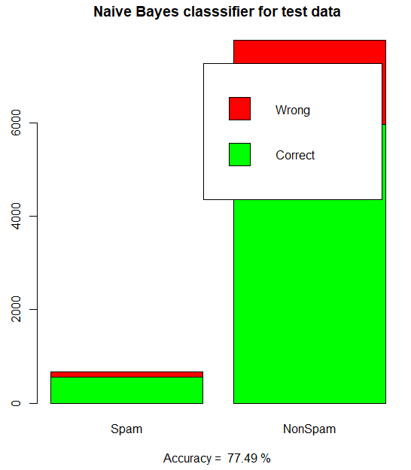
Accuracy Results for Naïve Bayes

Slide 27
NEURAL NETWORKS
Neural Network is based on a collection of connected units called artificial neurons.
NN1<-neuralnet(Class ~ Retweets + Favorites + New_Feature, traindataset.bkup, hidden=4, startweights = c(8,5)).
We have used Probabilistic neural networks.
The first layer computes the distance from the input vector to the training input vectors. This produces a vector where its elements indicate how close the input is to the training input.
Neural Networks resulted in an accuracy of 74.75%.

Slide 28
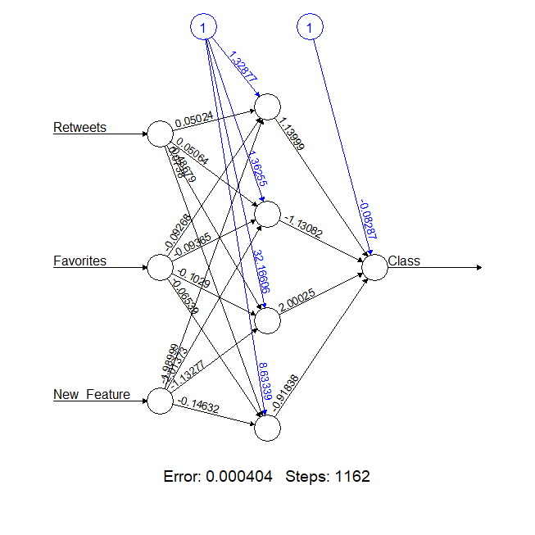
Neural Networks Model

Slide 29
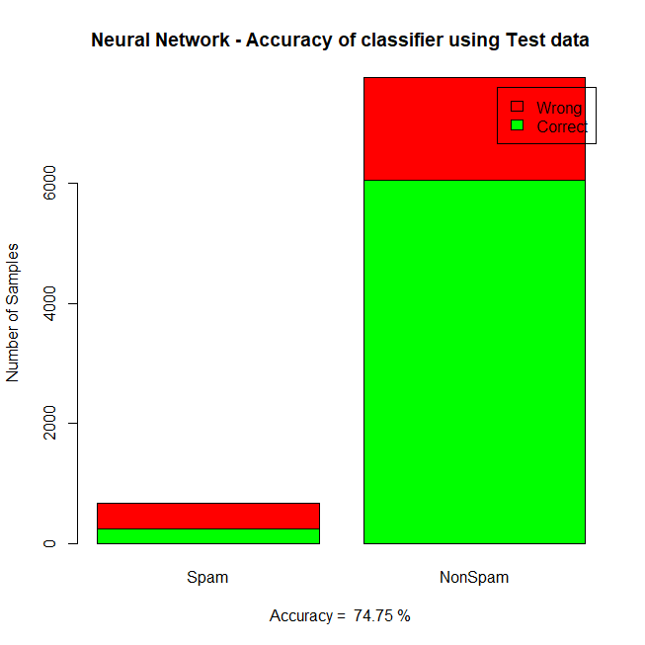
Accuracy Results for Neural Networks

Slide 30
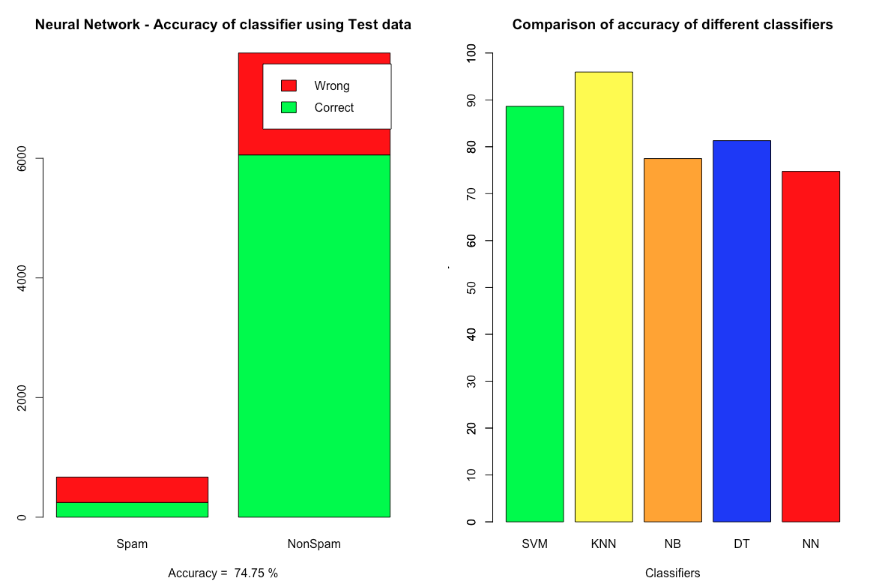
Comparison and Conclusion

Slide 31
Thank You

